Slide 1
Guide to Computer Forensics and Investigations
Fourth Edition
Chapter 1
Computer Forensics and Investigations as a Profession

Slide 2
Objectives
Define computer forensics
Describe how to prepare for computer investigations and explain the difference between law enforcement agency and corporate investigations
Explain the importance of maintaining professional conduct
Guide to Computer Forensics and Investigations

Slide 3
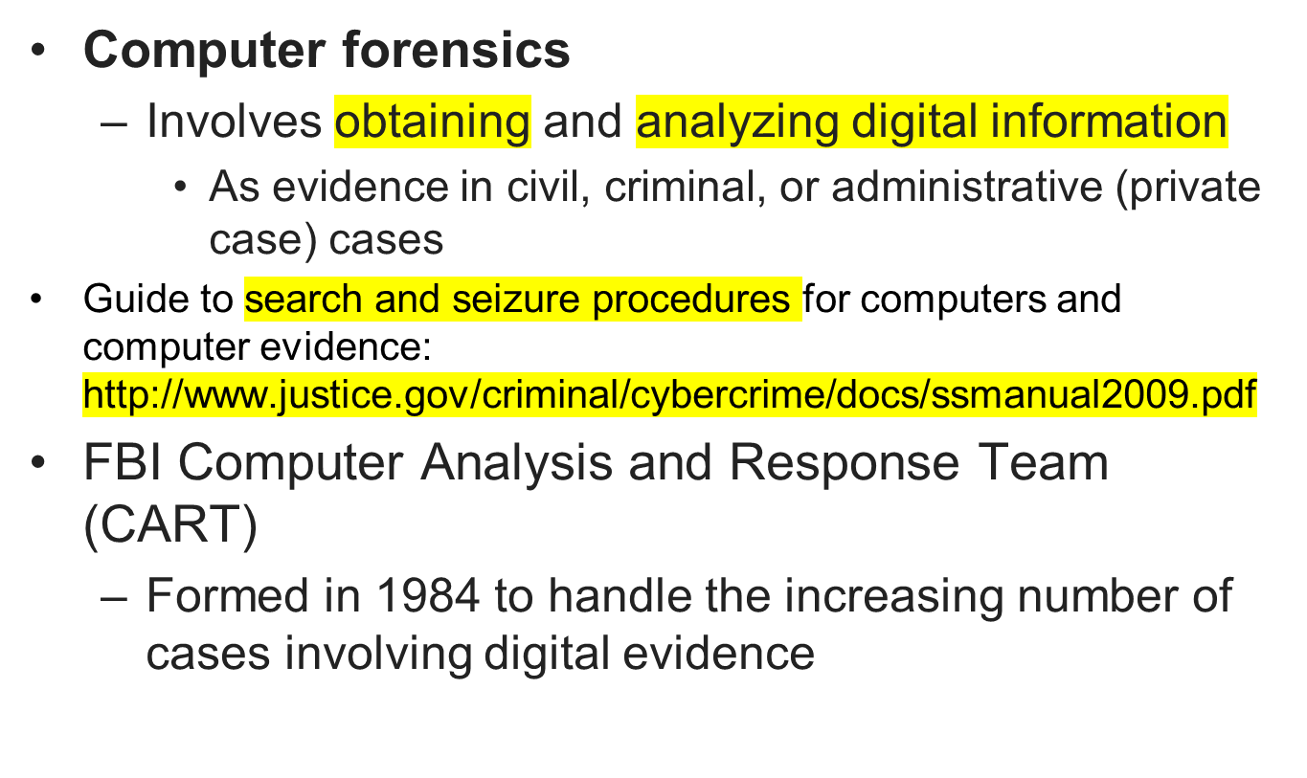
Understanding Computer Forensics
Guide to Computer Forensics and Investigations

Slide 4
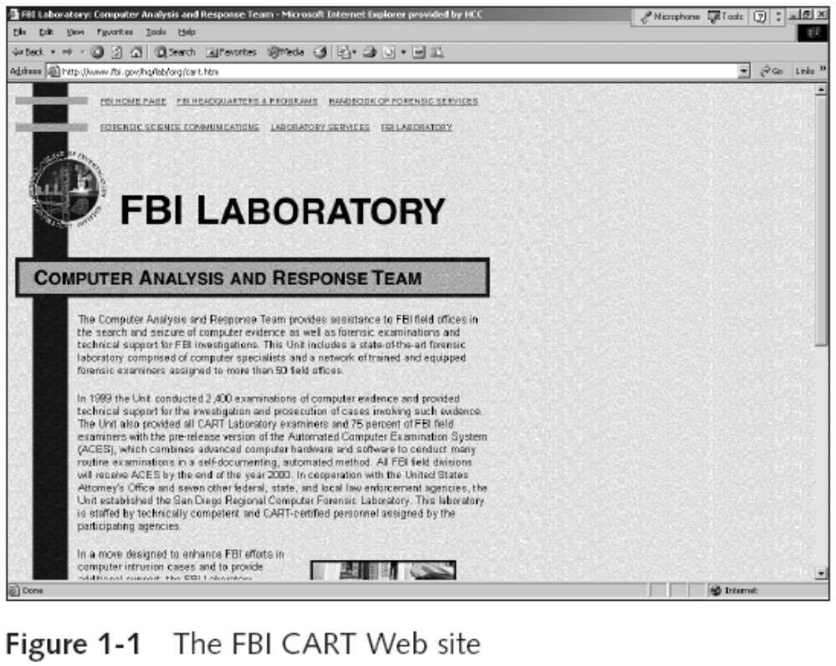
Understanding Computer Forensics (continued)
Guide to Computer Forensics and Investigations

Slide 5
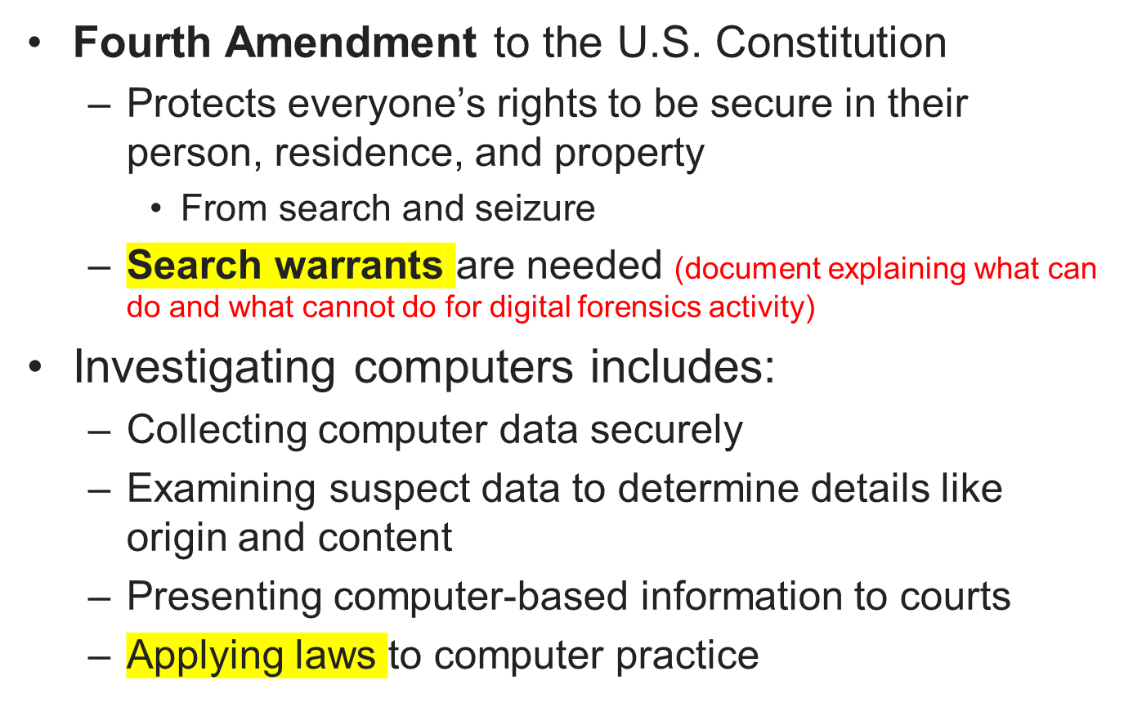
Understanding Computer Forensics (continued)
Guide to Computer Forensics and Investigations

Slide 6
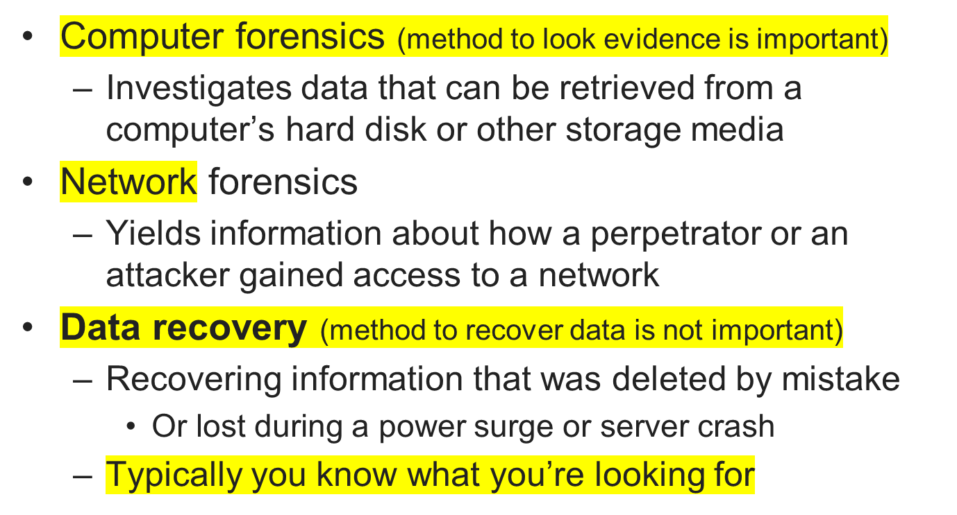
Computer Forensics Versus Other Related Disciplines
Guide to Computer Forensics and Investigations

Slide 7
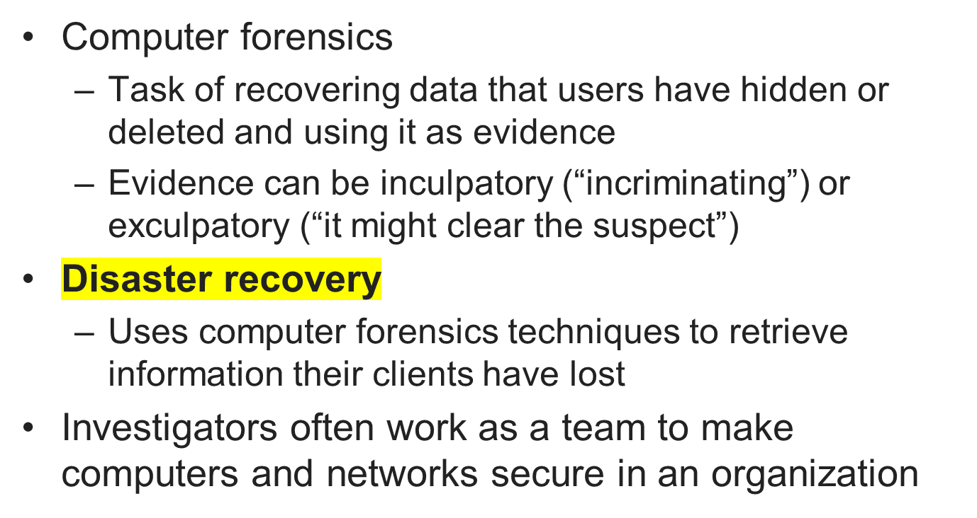
Computer Forensics Versus Other Related Disciplines (continued)
Guide to Computer Forensics and Investigations

Slide 8
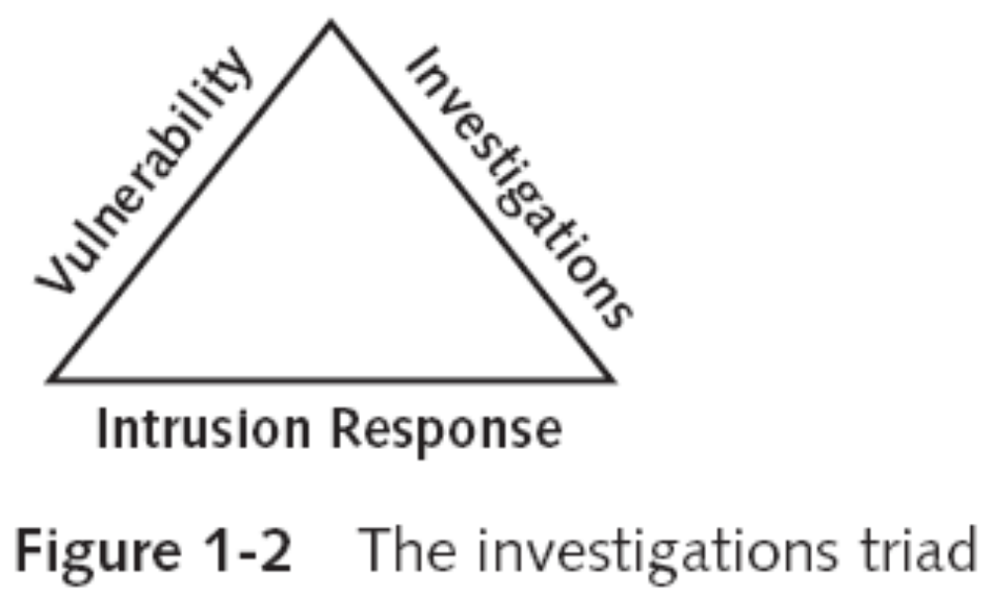
Computer Forensics Versus Other Related Disciplines (continued)
Guide to Computer Forensics and Investigations

Slide 9
Computer Forensics Versus Other Related Disciplines (continued)
Enterprise network environment
  Large corporate computing systems that might include disparate or formerly independent systems
Vulnerability assessment and risk management group
  Tests and verifies the integrity of standalone workstations and network servers
  Professionals in this group have skills in network intrusion detection and incident response
  Experienced in UNIX and Windows administration
Guide to Computer Forensics and Investigations

Slide 10
Computer Forensics Versus Other Related Disciplines (continued)
Litigation (lawyers)
  Legal process of proving guilt or innocence in court
Computer investigations group
  Manages investigations and conducts forensic analysis of systems suspected of containing evidence related to an incident or a crime
Guide to Computer Forensics and Investigations

Slide 11
A Brief History of Computer Forensics
By the 1970s, electronic crimes were increasing, especially in the financial sector
  Most law enforcement officers didn’t know enough about computers to ask the right questions
    Or to preserve evidence for trial
1980s
  PCs gained popularity and different OSs emerged
  Disk Operating System (DOS) was available
  Forensics tools were simple, and most were generated by government agencies
Guide to Computer Forensics and Investigations

Slide 12
A Brief History of Computer Forensics (continued)
Mid-1980s
  Xtree Gold appeared on the market
    Recognized file types and retrieved lost or deleted files
  Norton DiskEdit soon followed
    And became the best tool for finding deleted file
1987
  Apple produced the Mac SE
    A Macintosh with an external EasyDrive hard disk with 60 MB of storage
Guide to Computer Forensics and Investigations

Slide 13
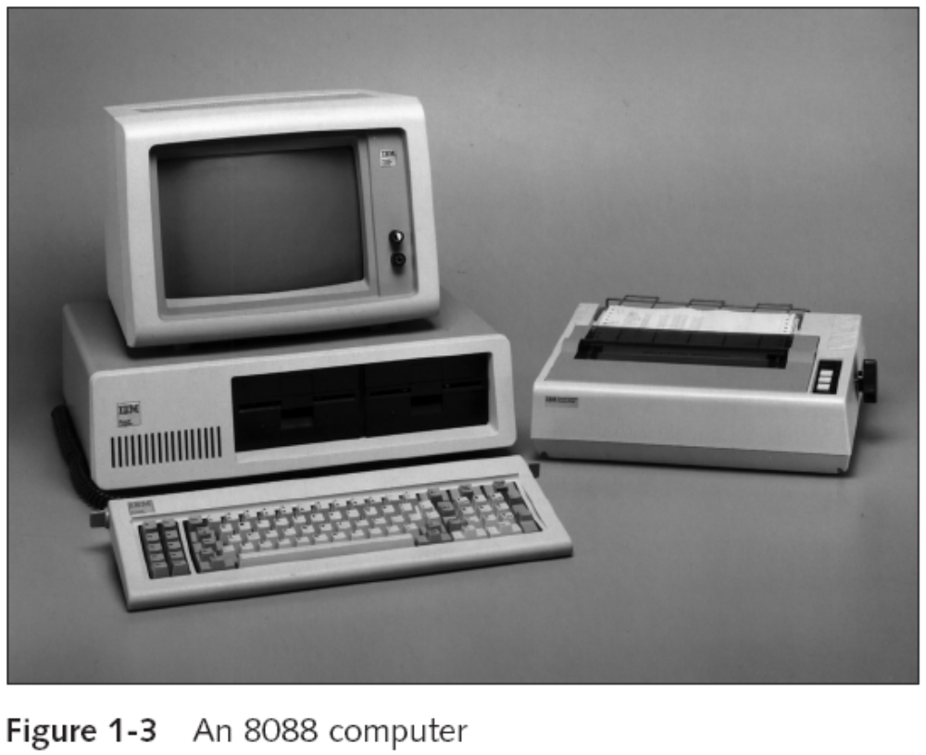
A Brief History of Computer Forensics (continued)
Guide to Computer Forensics and Investigations

Slide 14
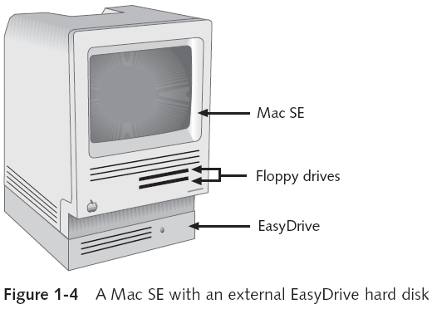
A Brief History of Computer Forensics (continued)
Guide to Computer Forensics and Investigations

Slide 15
A Brief History of Computer Forensics (continued)
Early 1990s
  Tools for computer forensics were available
  International Association of Computer Investigative Specialists (IACIS)
    Training on software for forensics investigations
  IRS created search-warrant programs
  ExpertWitness for the Macintosh
    First commercial GUI software for computer forensics
    Created by ASR Data
Guide to Computer Forensics and Investigations

Slide 16
A Brief History of Computer Forensics (continued)
Early 1990s (continued)
  ExpertWitness for the Macintosh
    Recovers deleted files and fragments of deleted files
Large hard disks posed problems for investigators
Other software
  iLook
    maintained by IRS Criminal Investigation Division & law enforcement
    Analyse and read special files that are copies of a disk
  AccessData Forensic Toolkit (FTK)
Guide to Computer Forensics and Investigations

Slide 17
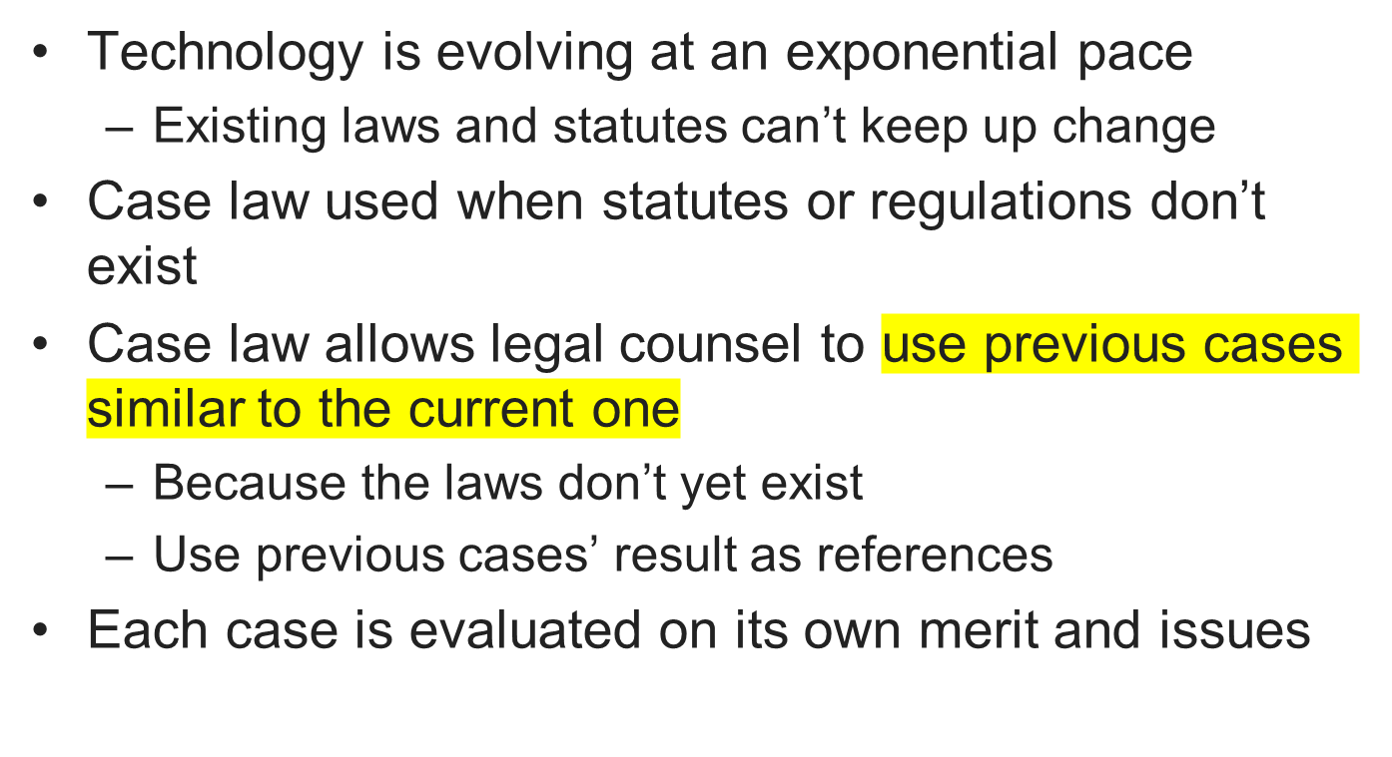
Understanding Case Law
Guide to Computer Forensics and Investigations

Slide 18
Developing Computer Forensics Resources
You must know more than one computing platform
  Such as DOS, Windows 9x, Linux, Macintosh, and current Windows platforms
Join as many computer user groups as you can
Computer Technology Investigators Network (CTIN)
  Meets monthly to discuss problems that law enforcement and corporations face
Guide to Computer Forensics and Investigations

Slide 19
Developing Computer Forensics Resources (continued)
High Technology Crime Investigation Association (HTCIA)
  Exchanges information about techniques related to computer investigations and security
User groups can be helpful
Build a network of computer forensics experts and other professionals
  And keep in touch through e-mail
Outside experts can provide detailed information you need to retrieve digital evidence
Guide to Computer Forensics and Investigations

Slide 20
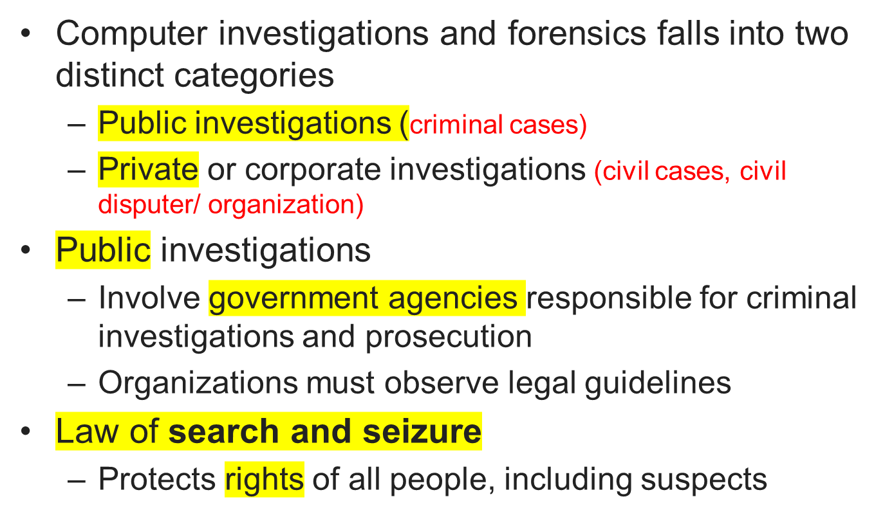
Preparing for Computer Investigations
Guide to Computer Forensics and Investigations

Slide 21
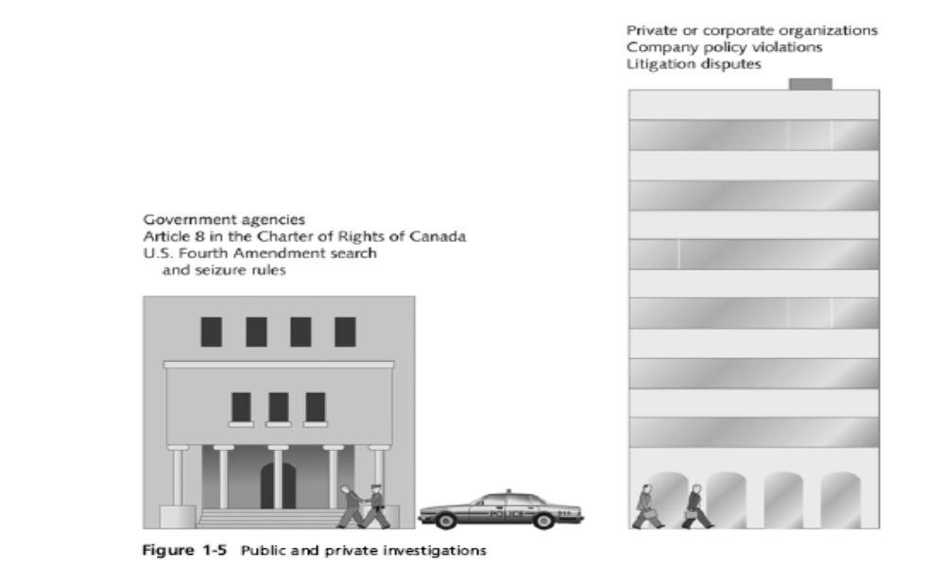
Preparing for Computer Investigations (continued)
Guide to Computer Forensics and Investigations

Slide 22
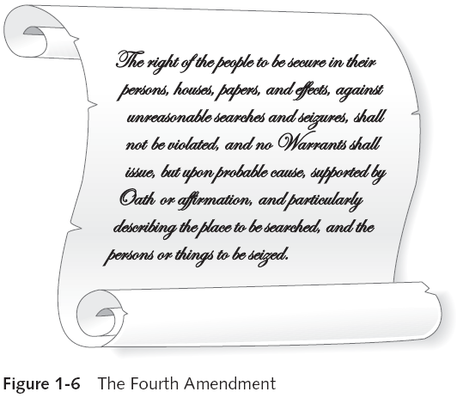
Preparing for Computer Investigations (continued)
Guide to Computer Forensics and Investigations

Slide 23
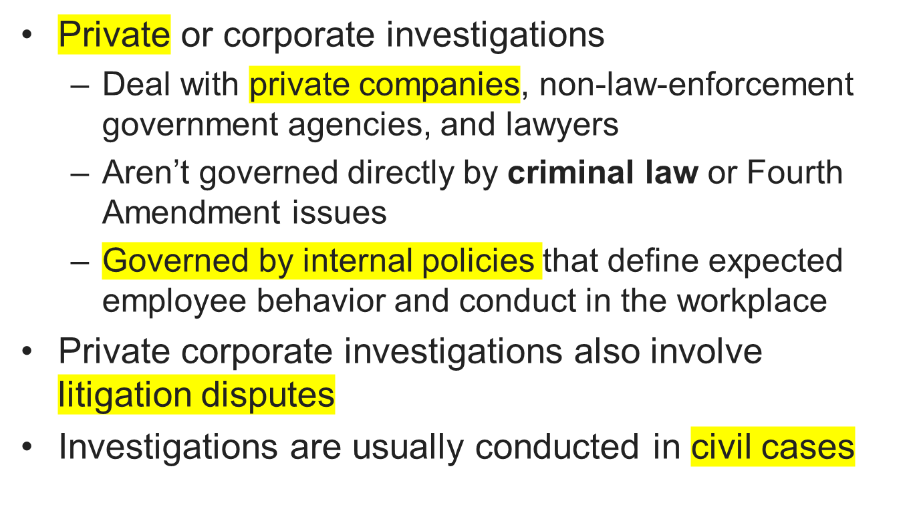
Preparing for Computer Investigations (continued)
Guide to Computer Forensics and Investigations

Slide 24
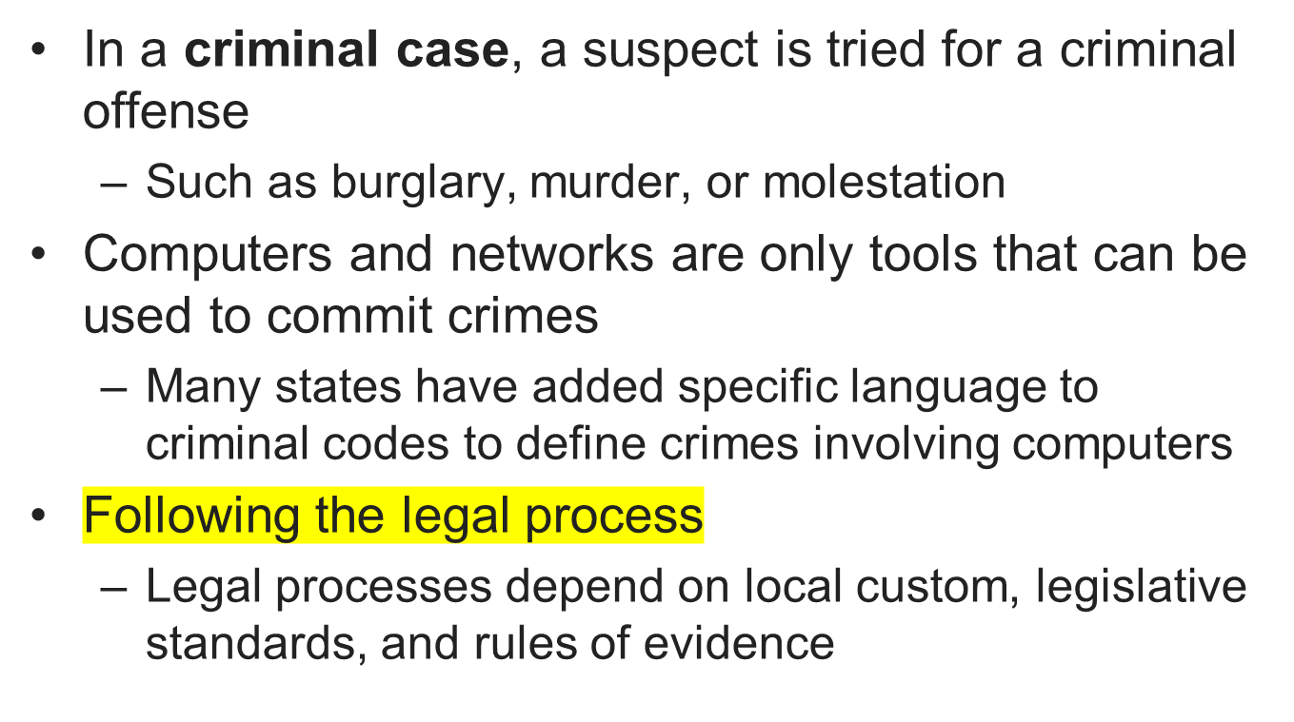
Understanding Law Enforcements Agency Investigations
Guide to Computer Forensics and Investigations

Slide 25
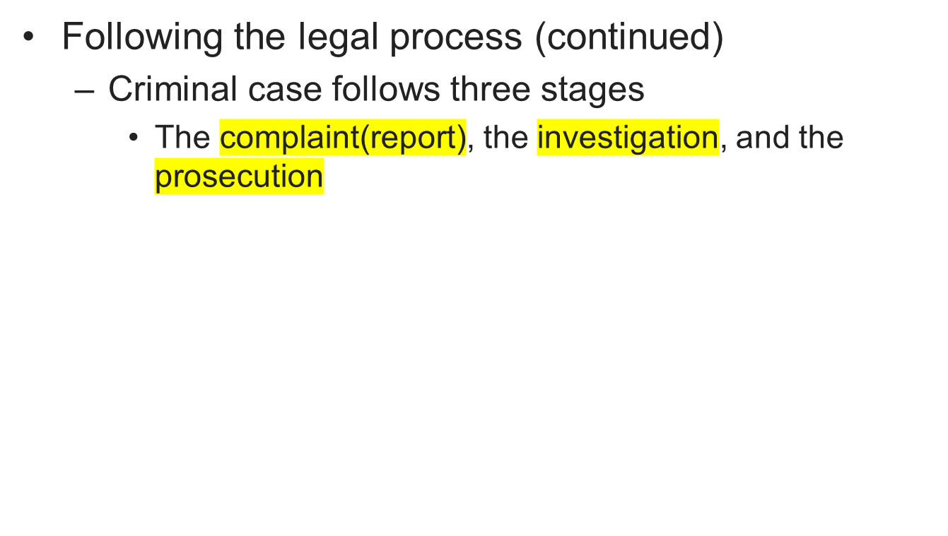
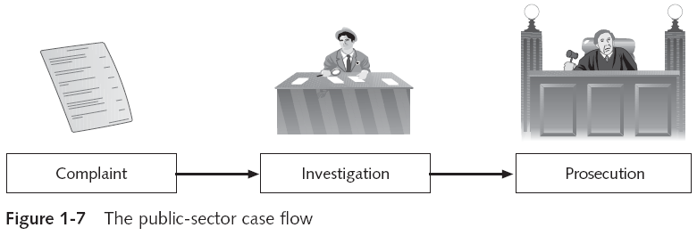
Understanding Law Enforcements Agency Investigations (continued)
Guide to Computer Forensics and Investigations

Slide 26
Understanding Law Enforcements Agency Investigations (continued)
Following the legal process (continued)
  A criminal case begins when someone finds evidence of an illegal act
  Complainant makes an allegation, an accusation or supposition of fact
  A police officer interviews the complainant and writes a report about the crime
    Police blotter provides a record of clues to crimes that have been committed previously
  Investigators delegate, collect, and process the information related to the complaint
Guide to Computer Forensics and Investigations

Slide 27
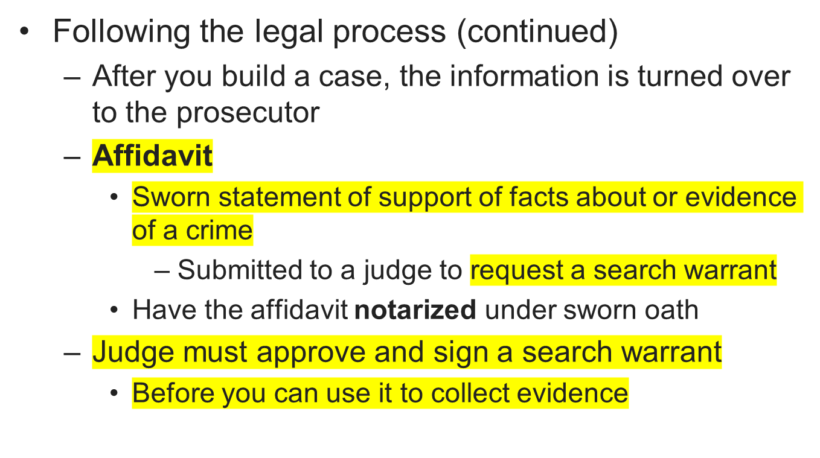
Understanding Law Enforcements Agency Investigations (continued)
Guide to Computer Forensics and Investigations

Slide 28
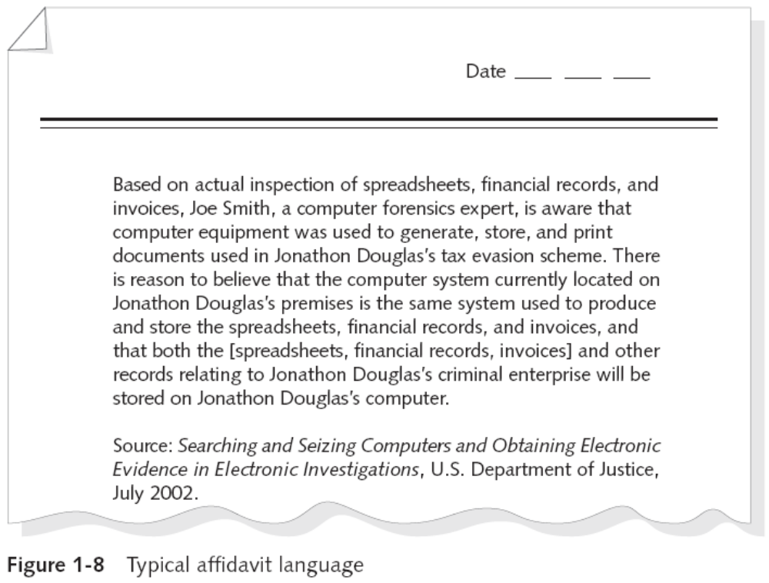
Understanding Law Enforcements Agency Investigations (continued)
Guide to Computer Forensics and Investigations

Slide 29
Understanding Corporate Investigations
Private or corporate investigations
  Involve private companies and lawyers who address company policy violations and litigation disputes
Corporate computer crimes can involve:
  E-mail harassment
  Falsification of data
  Gender and age discrimination
  Embezzlement
  Sabotage
  Industrial espionage
Guide to Computer Forensics and Investigations

Slide 30
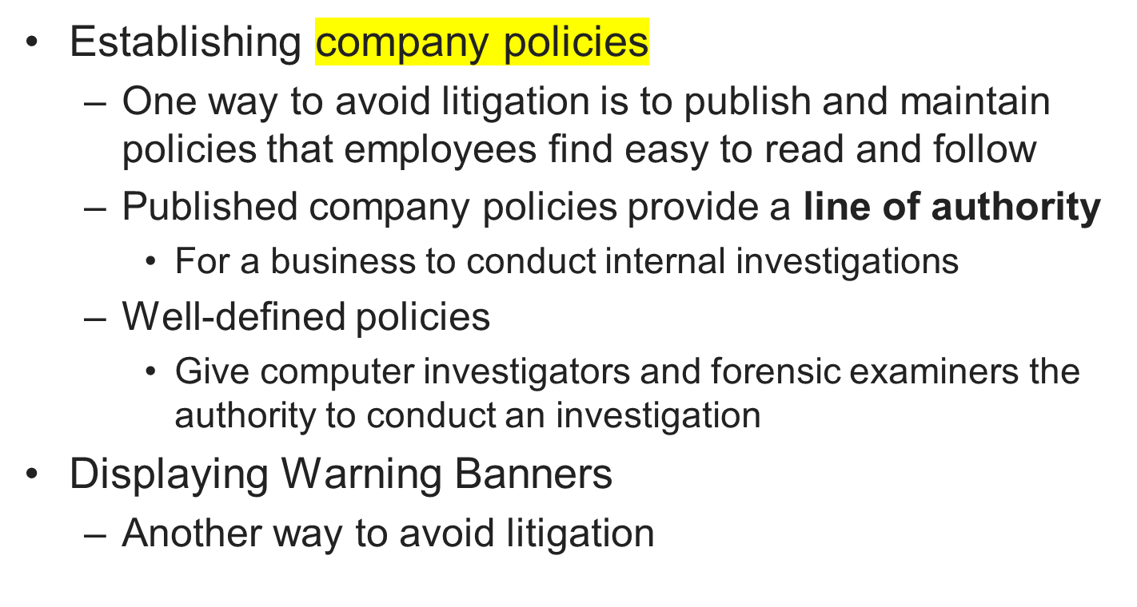
Understanding Corporate Investigations (continued)
Guide to Computer Forensics and Investigations

Slide 31
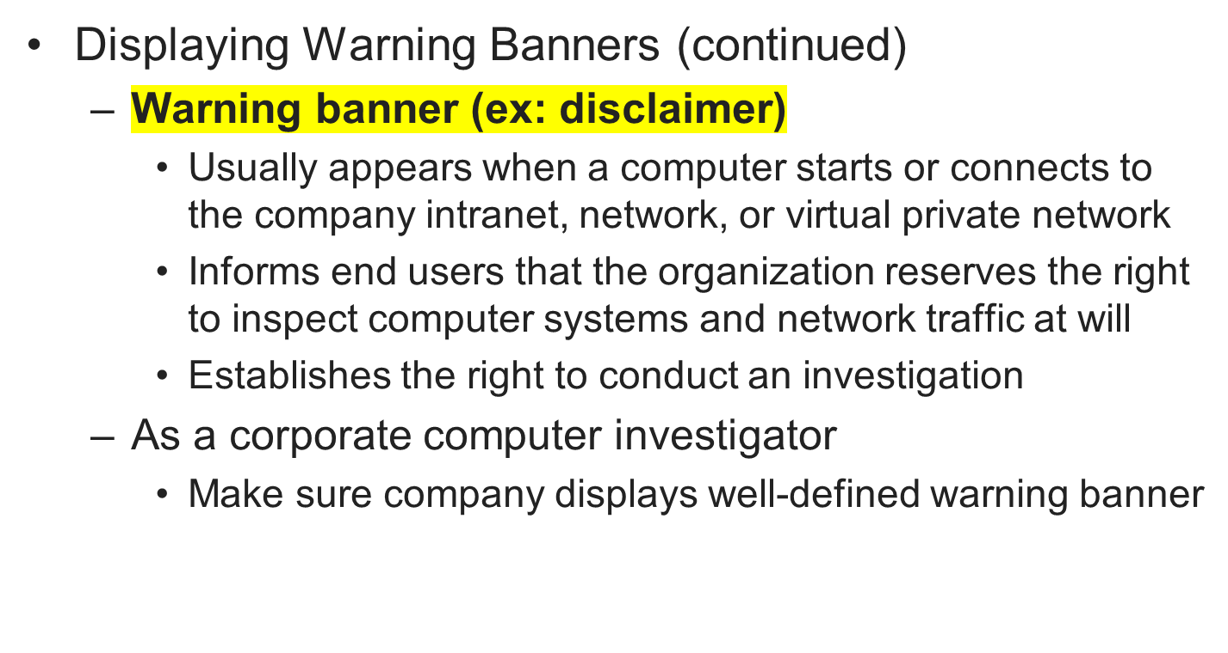
Understanding Corporate Investigations (continued)
Guide to Computer Forensics and Investigations

Slide 32
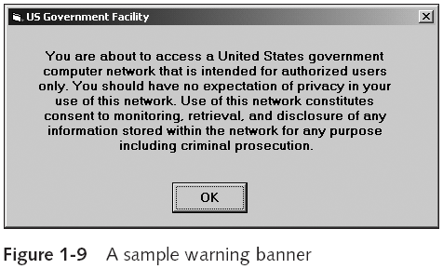
Understanding Corporate Investigations (continued)
Guide to Computer Forensics and Investigations

Slide 33
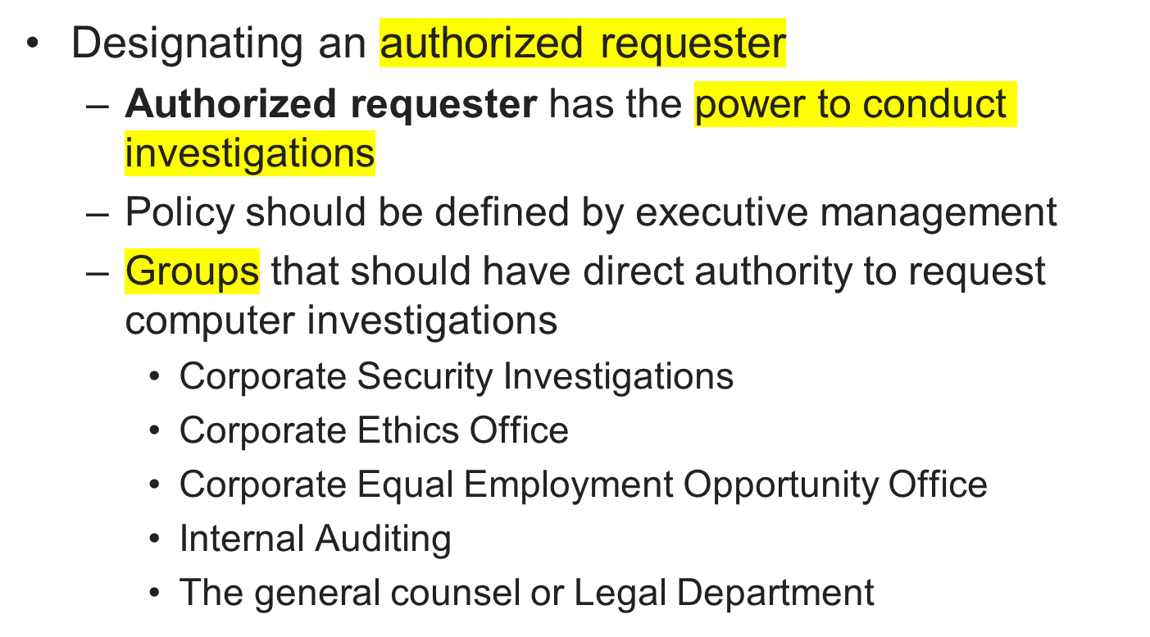
Understanding Corporate Investigations (continued)
Guide to Computer Forensics and Investigations

Slide 34
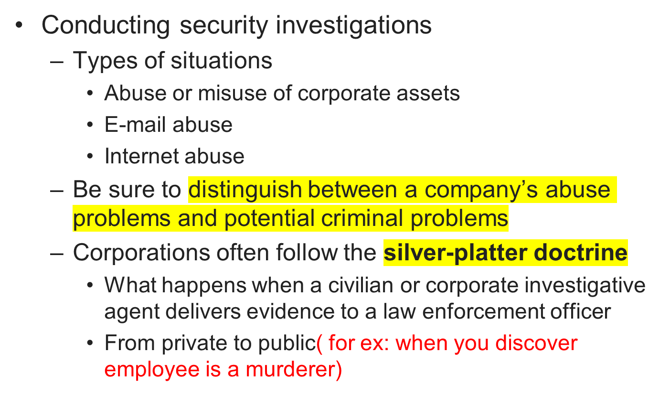
Understanding Corporate Investigations (continued)
Guide to Computer Forensics and Investigations

Slide 35
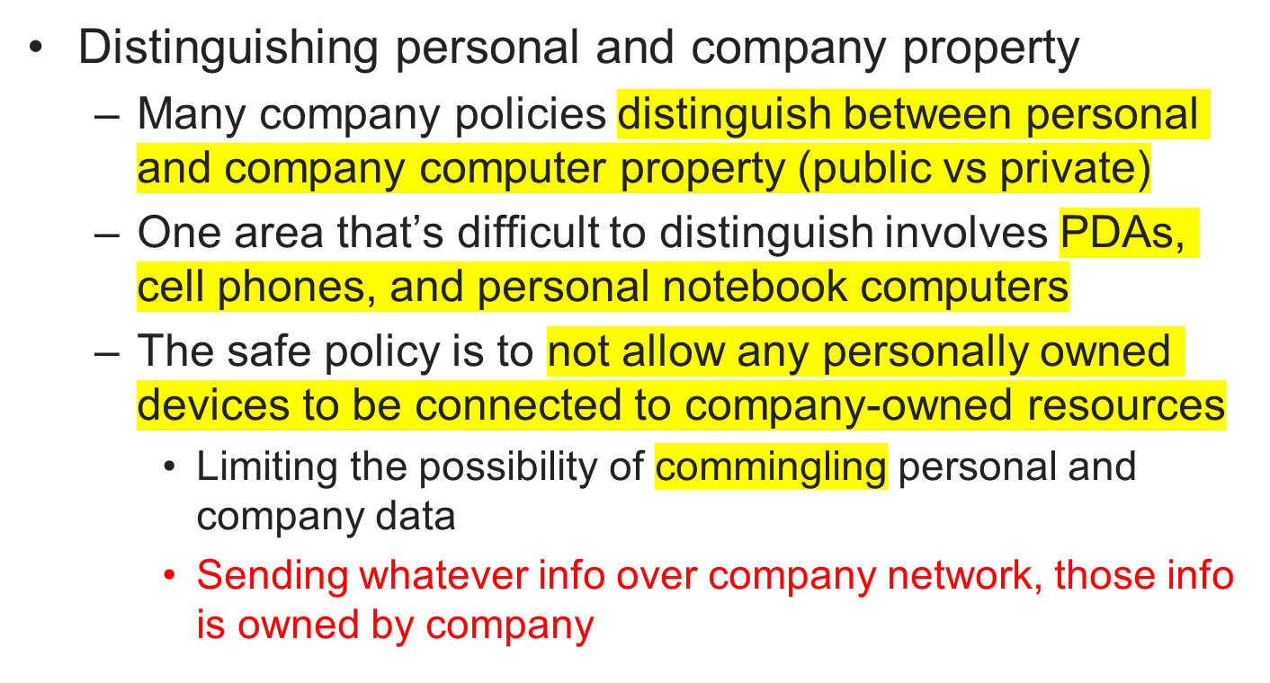
Understanding Corporate Investigations (continued)
Guide to Computer Forensics and Investigations

Slide 36
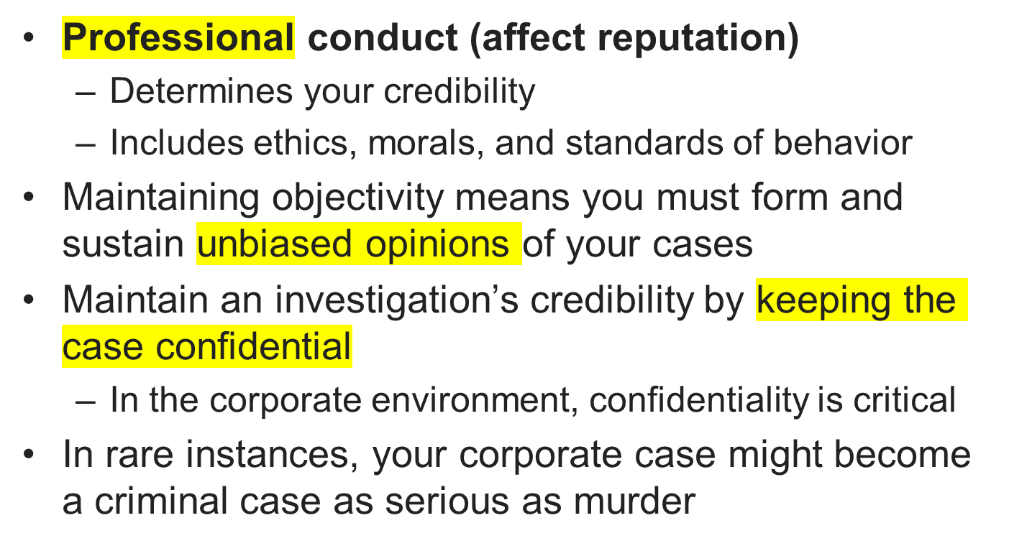
Maintaining Professional Conduct
Guide to Computer Forensics and Investigations

Slide 37
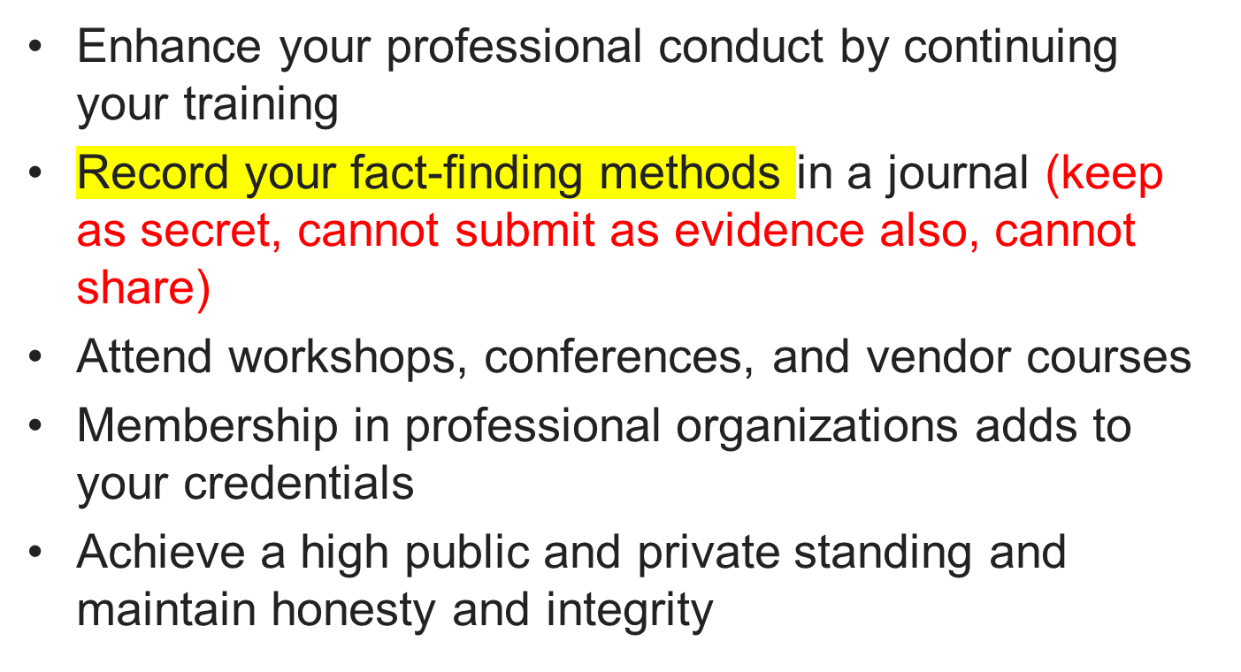
Maintaining Professional Conduct (continued)
Guide to Computer Forensics and Investigations

Slide 38
Summary
Computer forensics applies forensics procedures to digital evidence
Laws about digital evidence established in the 1970s
To be a successful computer forensics investigator, you must know more than one computing platform
Public and private computer investigations are different
Guide to Computer Forensics and Investigations

Slide 39
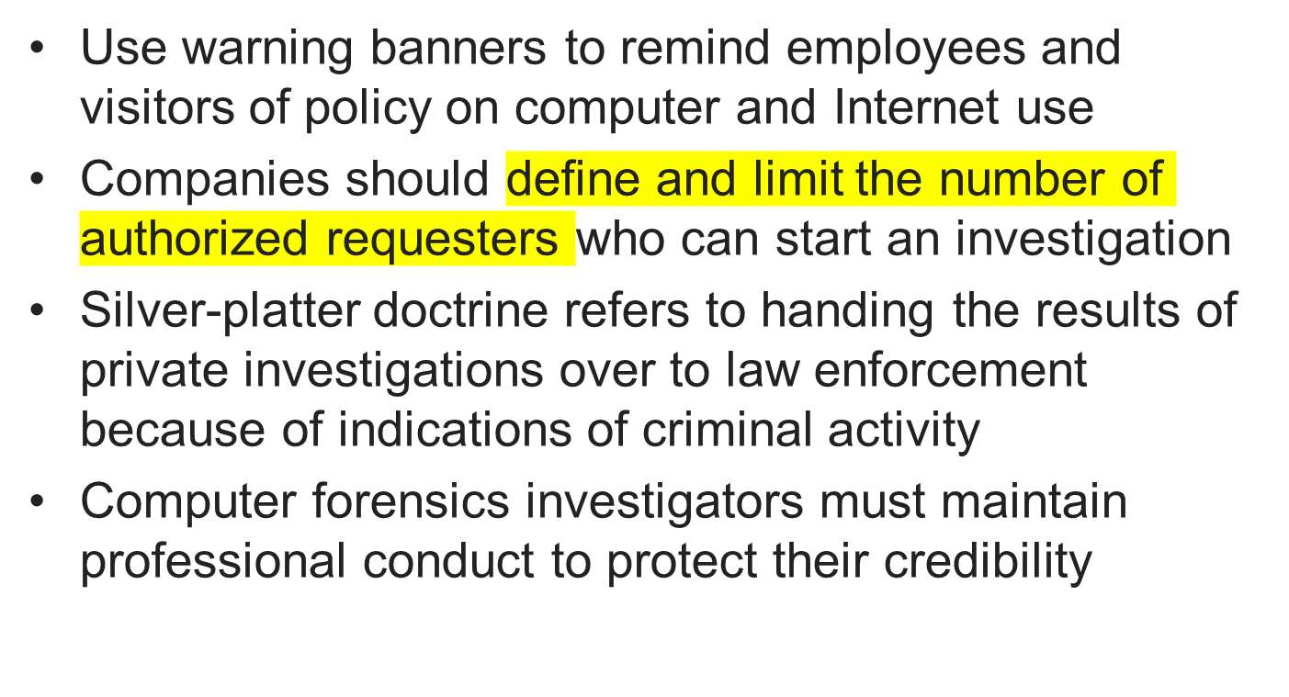
Summary (continued)
Guide to Computer Forensics and Investigations

Slide 40
Homework
Watch
“How to start a career in Computer Forensics”, https://www.youtube.com/watch?v=d0-4_Lx8kto&t=105s
“Digital Forensics” https://www.youtube.com/watch?v=Pf-JnQfAEew
Guide to Computer Forensics and Investigations

